Slide 1
Building block-diagonal attention kernel with attention bias
Eric Qu and Yiheng Du

Slide 2
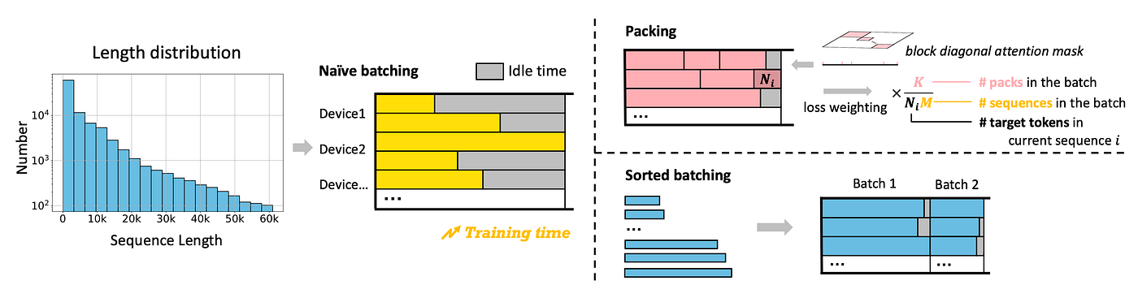
Problem Statement
People use packing to deal with irregular length

Slide 3
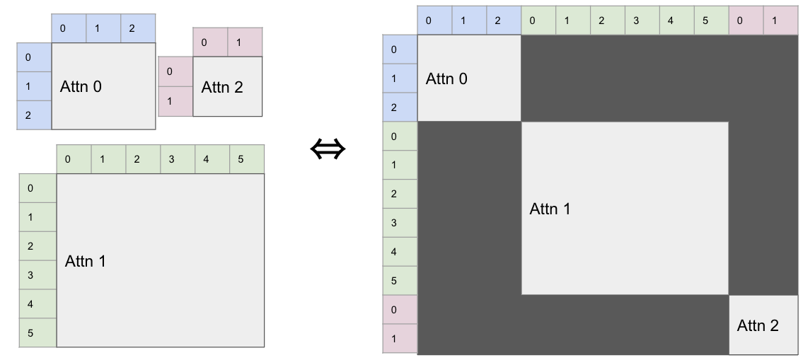
Problem Statement
This motivates the block-diagonal attention in language models

Slide 4
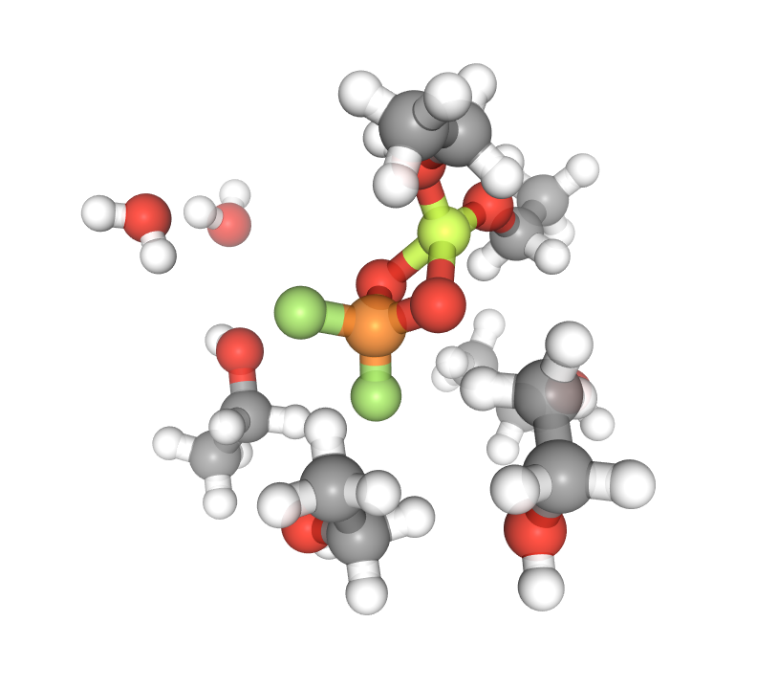
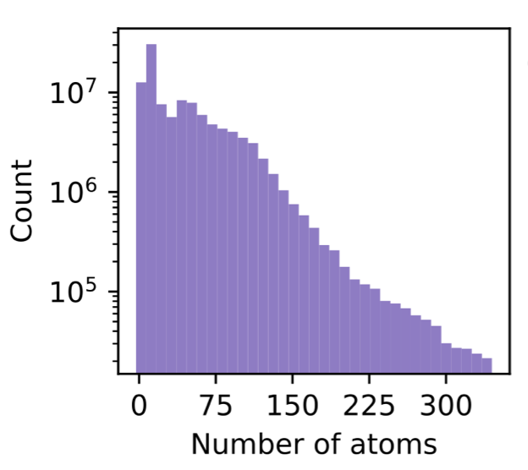
Problem Statement
In the field of AI for Chemical Sciences
State-of-the-art models uses attention across atoms to perform prediction
Training a batch of molecules consists of “packing” them together
The molecules are too small to fill the size for each CTA, making the tiling methods (eg flash attention) wasteful

Slide 5
Why Existing Kernels Fail
Navie Per-molecule Loop: Launches a separate flash attention kernel for each of the molecules. Each launch is far too small to saturate the GPU. This is too slow so not included.
Navie Explict Flash Attention: Extract all molecules, pad everything to max len, run a full flash attention on explicitly batched molecules. Padding become wasteful when batch size is large.
Flex Attention: Uses a compiled BlockMask to skip cross-molecule tiles. Fixed tile size 128, fixed boundary.

Slide 6
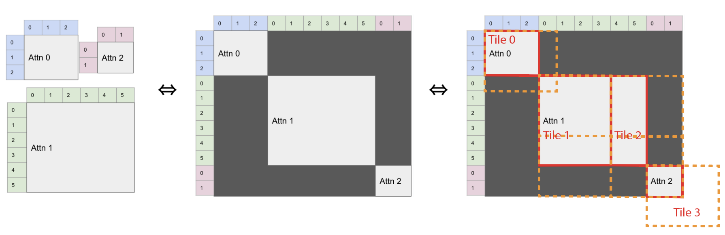
Kernel design: tiling scheme

Slide 7
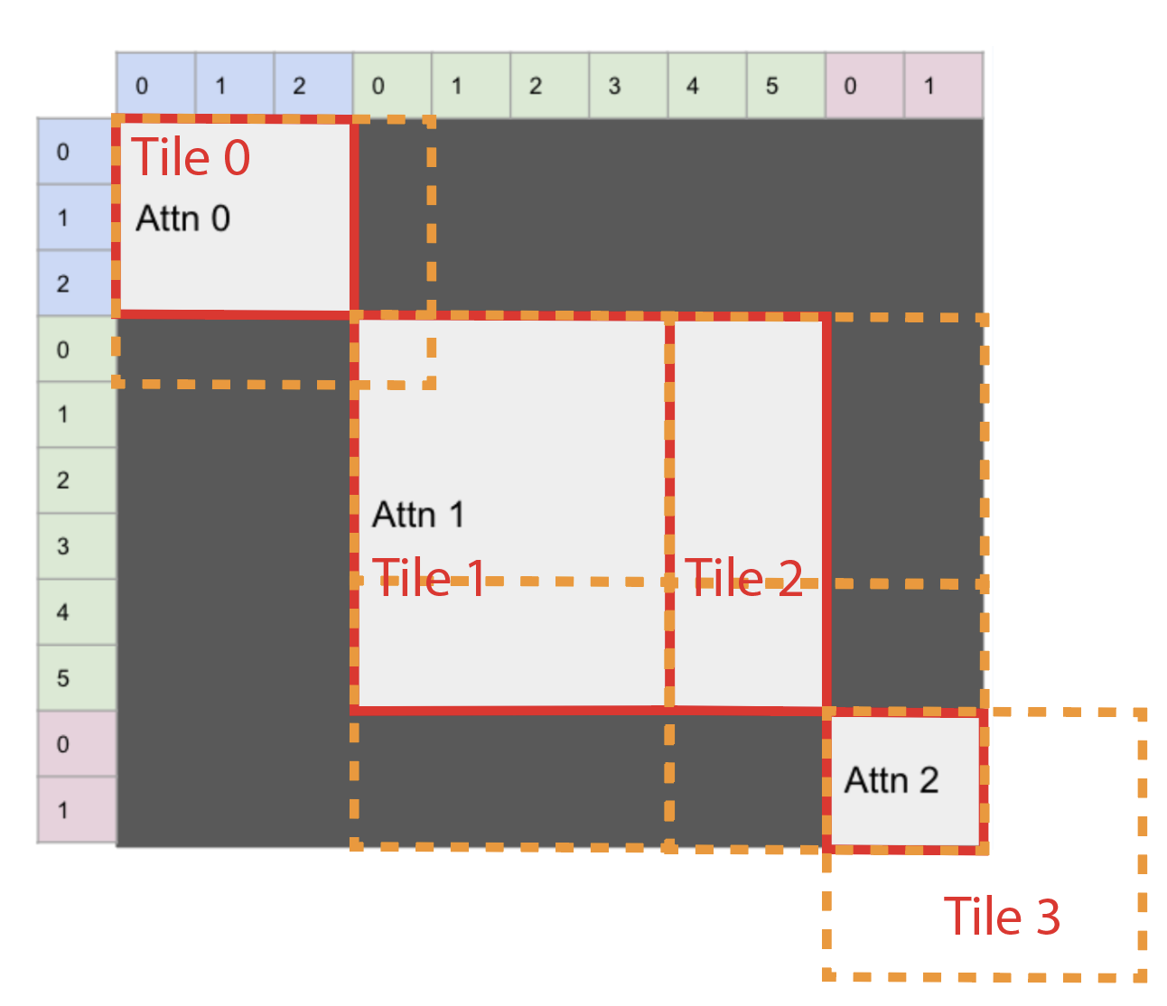
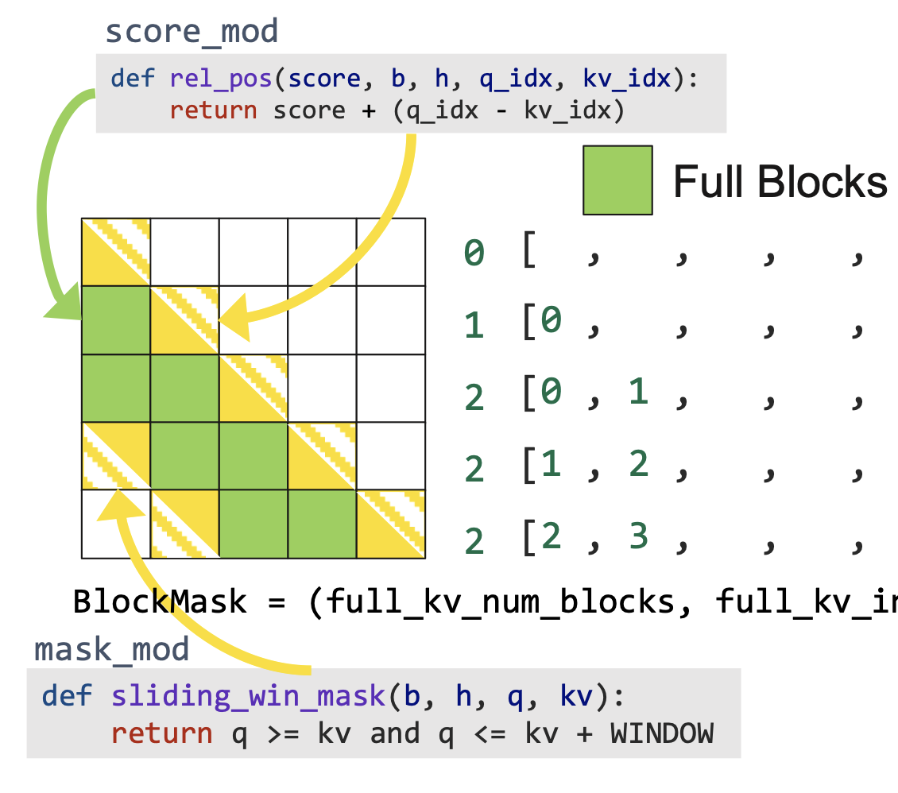
Kernel design: comparison
v.s.
Flash/Flex attention: fixed block boundaries
Ours: block-aware segmentation -> reduce padding

Slide 8
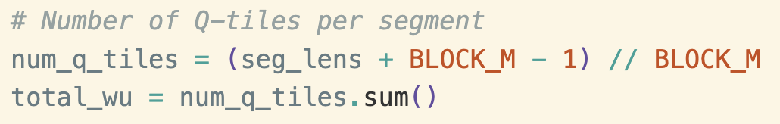
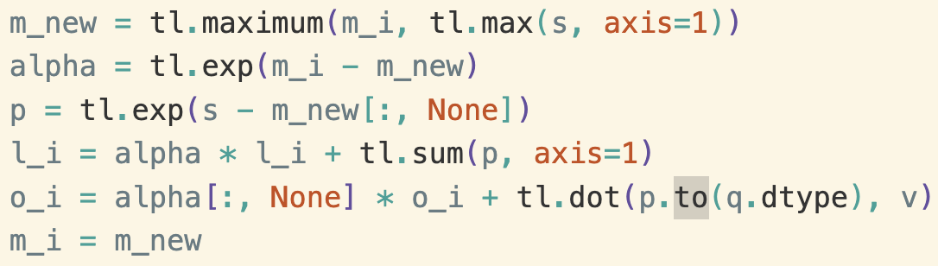
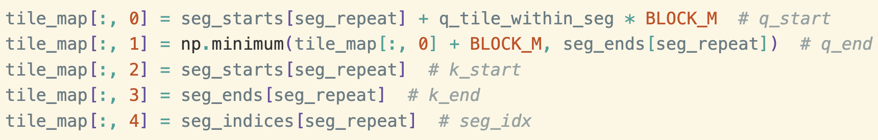
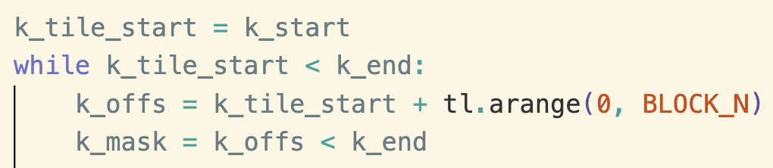
Kernel implementation
Tile scheduler
Triton kernel

Slide 9
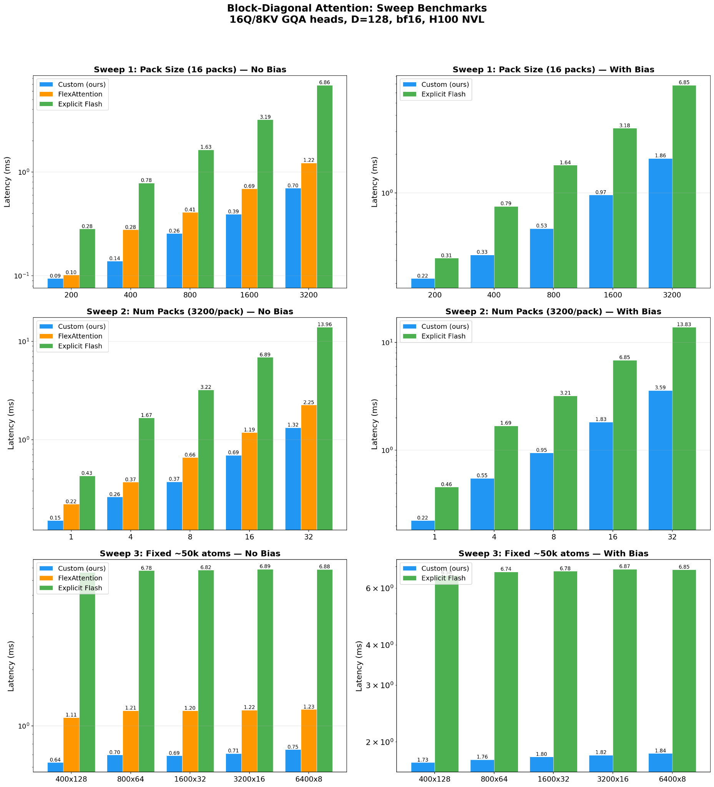
Latency: fix # of packs

Slide 10
Latency: fix pack size

Slide 11
Latency: fix total # of tokens

Slide 12
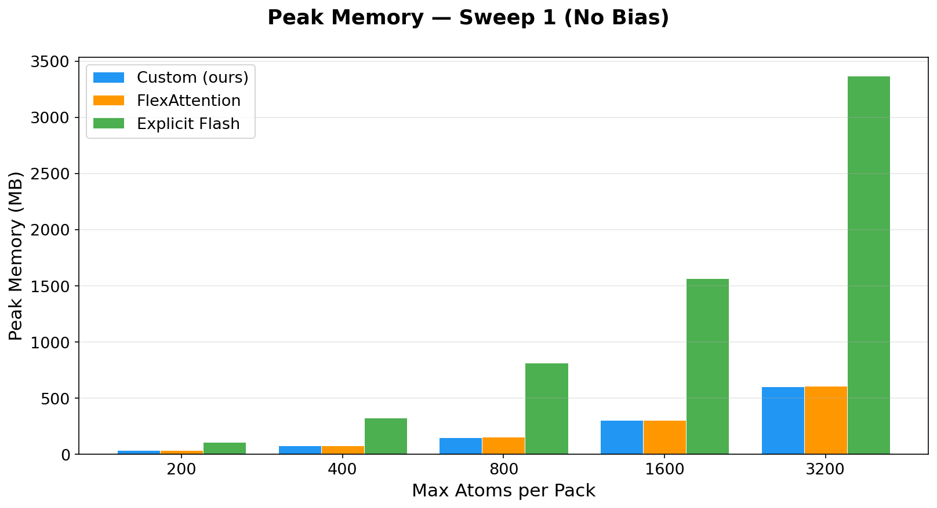
Peak memory usage

Slide 13
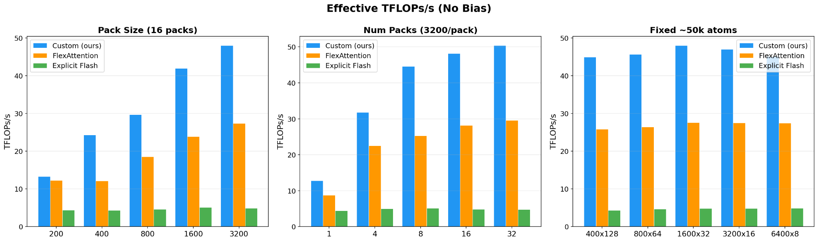
Effective TFLOP/s

Slide 14
Thank you!

